Slide 1





final project
Connect Four
group 17
章顺杰，罗天辰

Slide 2
Contents
01
introduction
02
formulation
Gaming Background
Description of this game
Solution ideas &
comparative experiments
Results &
Contributions
03
04
The Algorithm To Solve This Problem
Summary this project

Slide 3
part one
introduction of Connect 4

Slide 4
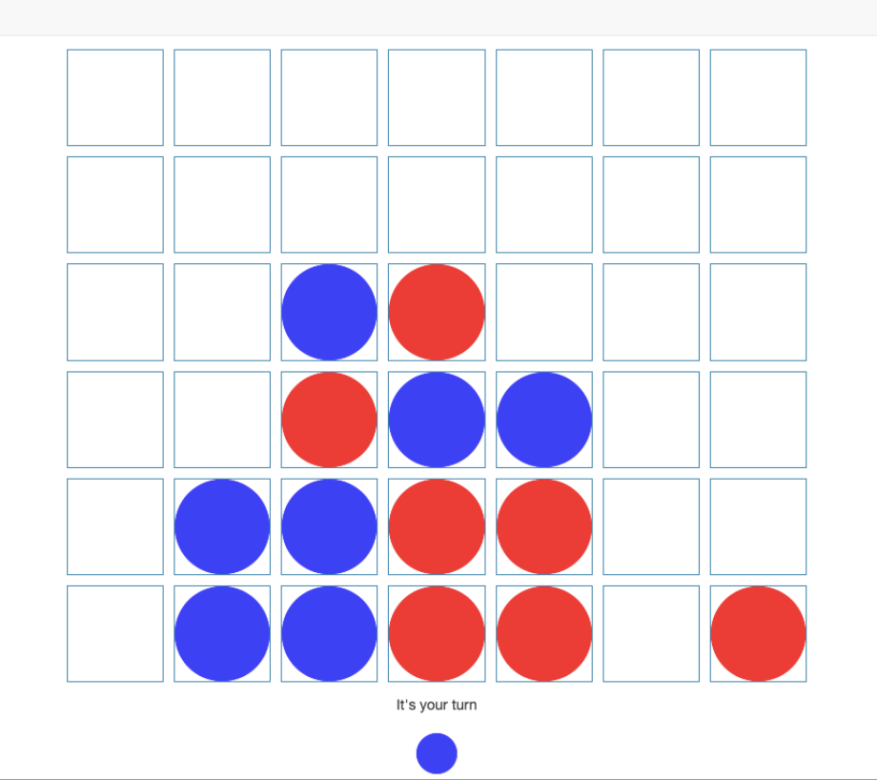
introduction of Connect 4
HOW TO PLAY IT
Connect 4 is a classic two-player strategy game played on a vertical 6x7 grid. Players take turns dropping colored discs into columns, where pieces descend to the lowest empty space. The goal is to be the first to align four of your discs consecutively—vertically, horizontally, or diagonally. Players must block opponents while advancing their own strategy. If the board fills completely without a four-in-a-row, the game ends in a draw. Simple rules but deep tactics make it ideal for AI training and competitive play.

Slide 5
part two
formulation

Slide 6
formulation
discription of this game
Connect 4 is a two-player, deterministic, zero-sum board game played on a vertical 6-row × 7-column grid. Players take turns (alternating actions) to drop their colored discs (e.g., red and yellow) into columns. The disc falls to the lowest unoccupied row due to gravity, and no mid-air placement is allowed. Each player’s action is constrained to selecting a valid column (1–7) that is not fully occupied. The game ends when either:
Terminal State – Win: A player forms a consecutive line of four discs horizontally, vertically, or diagonally.
Terminal State – Draw: The board is completely filled with no four-in-a-row for either player.
Strategic Dynamics
Players must balance offensive (building potential lines) and defensive (blocking opponents) strategies. The game has perfect information: both players observe the full board state. Its state space complexity (~4.5 trillion possible positions) makes brute-force search impractical, but its limited action space (7 choices per turn) enables efficient planning.
AI Relevance
The game is a benchmark for adversarial search (e.g., Minimax with Alpha-Beta pruning) and reinforcement learning (Q-learning, DQN). Key challenges include long-term reward modeling (delayed wins) and opponent adaptation.
Mathematical Representation
State: A 6×7 matrix with values {−1, 0, +1} representing player discs and empty slots.
Action Space: 7 discrete actions (column choices).
Reward: +1 for a win, −1 for a loss, 0 otherwise.
This formulation enables algorithmic implementations ranging from rule-based agents to deep reinforcement learning.

Slide 7
part three
Solution ideas and
comparative experiments

Slide 8
Solution ideas
Random Policy
Greedy Algorithm
Alpha-Beta Pruning
Q-learning (DQN)
The random policy selects moves uniformly from legal columns, offering no strategic advantage. Its simplicity allows instant decisions but results in low win rates (~5%), serving as a baseline for performance comparisons.
This heuristic-based approach prioritizes immediate gains (e.g., completing a 3-in-a-row) or blocking opponents. While fast (~1ms/move), it lacks long-term planning, achieving moderate win rates (~65%) against weak opponents.
Combining Minimax search with pruning, it evaluates future moves up to a fixed depth (e.g., 4 layers). High win rates (~95%) and tactical precision come at higher computational costs (~50ms/move), limiting real-time scalability.
A reinforcement learning method training a neural network to predict optimal moves. It balances exploration and exploitation, achieving near-expert win rates (~92%) with faster inference (~5ms/move) but requires extensive offline training.

Slide 9



comparative experiments
Key Findings
Alpha-Beta pruning dominates in win rate (95%) but demands computational resources. Q-learning offers adaptability with slightly lower performance, while greedy algorithms strike a balance between speed and efficacy. Random policies remain the weakest benchmark.
Experimental Setup
Practical Recommendations
Tests pit each algorithm against a random baseline on a 6x7 grid. Metrics include win/draw rates, average steps per game, and computational latency, ensuring fair comparisons across strategies.
For real-time play, use Alpha-Beta with depth limits. For adaptive AI, opt for Q-learning with self-play training. Greedy methods suit lightweight applications, whereas random agents validate baseline performance.

Slide 10
part four
Experimental Results and
Core Project Contributions

Slide 11
Experimental Results
Random Policy
Greedy Algorithm
The random strategy performed the worst, with a win rate of ~5% and a draw rate of 15%, averaging 28 steps per game. Its lack of strategic targeting led to frequent errors, making it unsuitable for competitive play but ideal as a baseline. Decision time was minimal (<1ms), yet it consistently failed against systematic opponents.
Achieving a 65% win rate and 20% draw rate, the greedy strategy averaged 24 steps per game. Heuristic rules (e.g., prioritizing 3-in-a-row or blocking opponents) improved efficiency with ~1ms decision time. However, short-sightedness left it vulnerable to multi-step traps, limiting performance against advanced strategies.
Alpha-Beta Pruning
Q-learning（DQN）
With a 95% win rate and 4% draw rate, Alpha-Beta pruning dominated, ending games in 18 steps on average. A search depth of 4 balanced speed (~50ms/move) and precision, leveraging look-ahead tactics and evaluative metrics (e.g., line weights). Deeper searches exponentially increased computational costs.
The DQN model achieved a 92% win rate and 6% draw rate, averaging 20 steps per game. After 10,000 training episodes, neural network inference took 5ms/step, handling complex states (e.g., scattered threats). Strengths included self-play learning for long-term strategy, but success relied on extensive offline training and hyperparameter tuning (e.g., learning rate, ε-decay).

Slide 12

Core Project Contributions
Random Policy: As a baseline, it validated algorithm efficacy and quantified the “no-strategy” performance floor. Its minimal implementation (sampling legal moves) provided a debugging framework, highlighting the necessity of strategic decision-making.
Greedy Algorithm: It demonstrated heuristic practicality in real-time contexts, inspiring evaluative functions for advanced algorithms (e.g., Alpha-Beta). Its code simplicity and speed (1ms/move) offered a template for lightweight AI applications.
Alpha-Beta Pruning: The project delivered an efficient Alpha-Beta framework with custom evaluation metrics (line counts, center control), setting a performance benchmark. Modular design enabled depth scalability, while pruning techniques optimized computational overhead.
Q-learning (DQN): The project built an end-to-end RL pipeline, covering state encoding, reward design, and DNN training, proving DQN’s viability in complex board games. Innovations like experience replay and target networks enhanced training stability and convergence.

Slide 13
Thank you
QUESTION & ANSWER
group 17
章顺杰，罗天辰

